Slide 1




Employment Accessibility: A Practical Guide for Workplace Parties
An implementation guide for CAN/ASC-1.1: 2024 (RE-2025)-Employment
Authors (alphabetical by last name): Andrew Dixon, Dilshan Fernando, Peter Field, Matthew Freeman, Rebecca Gewurtz, Andrew Livingston, Mahadeo Sukhai, Emile Tompa
vraie-idea.ca

Slide 2
Implementation Guide Team
Andrew Dixon, Research Associate, IDEA
Dilshan Fernando, Research Associate, IDEA
Peter Field, Accessibility and Inclusion Consultant
Matt Freeman, Assistant Clinical Professor, Rehabilitation Sciences, McMaster University
Rebecca Gewurtz, Director, IDEA; Associate Professor, McMaster University
Andy Livingston, Chief Executive Officer, Dexterity Consulting
Mahadeo Sukhai, COO, IDEA-STEM; Adjunct Professor, Faculty of Business and Information Technology, Ontario Tech University
Emile Tompa, Executive Director, IDEA; Senior Scientist, Institute for Work & Health

Slide 3
The Project Team
Our team includes accessibility experts from different disciplines, some of whom are person with lived experience
Members include policy advisors, human resources expertise, systems thinkers, and academics
Several of the team members are on the Employment standard technical committee

Slide 4
CAN/ASC 1.1: 2024 (REV-2025)- Employment
A revised version of the ASC standard was released at the end of May by Accessibility Standards Canada, available at https://accessible.canada.ca/creating-accessibility-standards/summary-can-asc-112024-rev-2025-employment
The standard envisions a work environment that is accessible, inclusive, barrier-free, and discrimination-free for all workers, including persons with disabilities
It draws on a social model of disability
It promotes removing barriers and providing accommodation without the need for disclosure
Ultimately, the focus is on creating work environments that are inclusive by design

Slide 5
Technical Committee Members
Project Manager
Quinn Redekop, Senior Program Advisor, Accessibility Standards Canada
Persons with disabilities and public interest
Mahadeo Sukhai, Researcher, self-employed (Chairperson)
Andrew Livingston, Chief Executive Officer, Dexterity Consulting (Vice Chairperson)
Gary Malkowski, Consultant, self-employed
Monique Beaudoin, Consultant (semi-retired)
Norma McCormick, Founder and Principal, Corporate Health Works Incorporated
General interest
Don Gallant, National Director, Ready Willing and Able, Inclusion Canada
Emile Tompa, Senior Scientist, Population/Workforce Studies Program, Institute for Work & Health
Mark Wafer, Chair, Board of directors, Canadian Hearing Services
Wendy Lau, Chief Executive Officer, Leads Employment Services
Policy makers
Christine Lund, Policy and Program Analyst, Indigenous Services Canada (ISC)
Emmanuelle Lopez-Bastos, Human Rights, Equity and Diversity Coordinator, United Food and Commercial Workers Union
Glen Hayes, Senior Human Resources Advisor, Treasury Board Secretariat
Kelsey Baker, Compensation Consultant, Nova Scotia Education Common Services Bureau
Orelie Di Mavindi, Manager, Opportunities Fund for Persons with Disabilities, Employment and Social Development Canada
Seema Lamba, National Human Rights Officer, Public Service Alliance of Canada
Pamela Lahey (Member October 2020-April 2024)
Standards users
Jamie Burton, Chief Executive Officer, INNoVA
Rachel Desjourdy, Accessibility Lead, CBC/Radio-Canada
Steven Lewis, Manager, Senior Legal Counsel and Accessibility Advisor, Capital One Bank (Canada)

Slide 6
Core modules of the standard
There are five core modules/clauses in the standard
  Clause 10: Structural support, policy, and leadership
  Clause 11: Culture, engagement, and education
  Clause 12: Recruitment, hiring, and onboarding
  Clause 13: Retention and career development
  Clause 14: Development and maintenance of an accessibility support system
https://accessible.canada.ca/creating-accessibility-standards/can-asc-112024-rev-2025-employment

Slide 7
Why is an implementation guide needed?
In general, a standard describes the set of requirements that an organization needs to have in place to meet certain expectations, in this case, being an inclusive employer
Implementation guidance provided advice on the process to achieve the requirement of a standard
The distinction is sometime described as the what (i.e., the standard) versus the how (i.e., the implementation guidance)
In general, standards are written to be broadly applicable, and guidance assists with contextualizing the requirements
The guide we are developing is being design support implementation of the ASC Employment standard in different contexts
The process of implementation will vary based on the unique circumstance of each organization

Slide 8
Core modules in the guidance
Developing an employment accessibility strategy
Creating a new normal through leadership and culture
Inclusive recruitment, hiring and onboarding
Inclusive retention, promotion and career development
Creating and maintaining an accessibility support system
Emphasis is given to measurement, evaluation and reporting, as well as keeping up with accessibility compliance

Slide 9
Other key modules in the guidance
Inclusive technology and communications
Removing barriers
Accessibility compliance and best practices
The guide will also have a module describing key concept and annexes with supplement information on tools and resources to support implementation

Slide 10
Systems approach to capacity building
Traditional approach used to address disability inclusion issues within organizations
  Assign responsibilities to a particular person or a team responsible for human resources
  Organizations often take a reactive role to accommodation needs, only addressing them as requests are made
Systems approach is proactive and considers roles and responsibilities across the organizations
  Considers inputs, process, outputs and feedback
  Evaluation and improvement on a continual basis
  In the disability inclusion space, the intent is to ultimately become inclusive by design

Slide 11
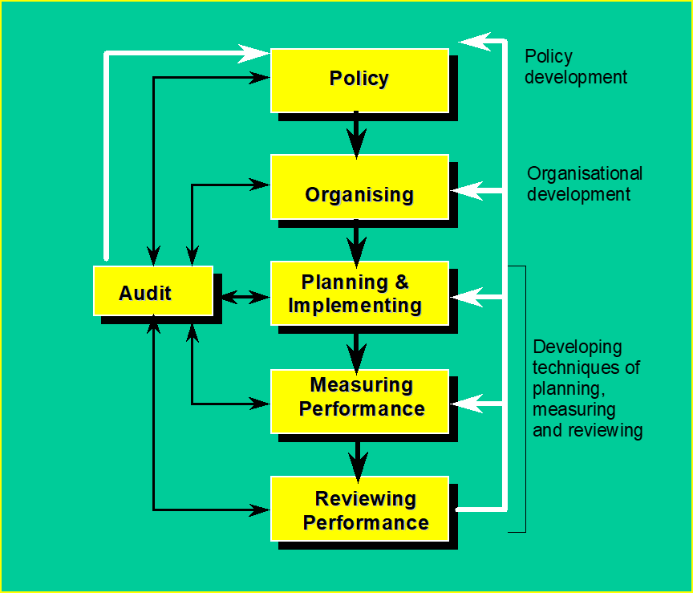
Management System Model*
Policies play a fundamental role in setting clear directions for organizations to follows
Management structures need to be in place to deliver on policies
Requires a planned and systematic approach to implementing policies
Emphasis is given to measurement of performance against targets to identify needed improvements
Reviews and learning from experiences are fundamental to continual improvement
*Health and Safety Executive Model (HSG65)

Slide 12
Continual improvement
A centrepiece of the approach we take is a focus on systems change through continual improvement
Continual improvement is an ongoing effort to refine a particular area of organizational activities through periodic cycles, specifically:
  developing plans and target
  implementing the plans
  measuring and evaluating progress and outcome
  acting on the findings of evaluations to ensure targets are met
Plan-Do-Check-Act (PDCA) is common approach to operationalizing a continual improvement process

Slide 13
Continual Improvement Cycle
Plan-Do-Check-Act (PDCA)
Continual Improvement Cycle
1. Plan: Establish improvement objectives
2. Do: Implement the plan
3. Check: Monitor and evaluate progress
4. Act: Review and take action to improve
Example of review consideration
Do current recruitment, hiring and onboarding practices provide opportunities for persons with different types of disabilities to access employment opportunities within the organization?
What policies and procedures, roles and responsibilities, resources and skills need to be in place to ensure inclusive practices?

Slide 14
Next Steps
We are looking to get a beta draft of the guidance for public review out in the early summer
We will be seeking feedback on the beta draft which we will review and use to fine tune the guidance
Ideally, we hope to finalize the guidance by late summer

Slide 15
Funding Acknowledgement
Inclusive Design for Employment Access (IDEA) is supported by generous funding from the Government of Canada’s New Frontiers in Research Fund (NFRF).
Le Vision Radicale Pour L’Accès Inclusif à l’Emploi (VRAIE) est financé par le fonds Nouvelles frontières en recherche du gouvernement du Canada.
Notes:
This is our standard acknowledgement

